Slide 1

Project GROW
Predictive self-sustaining irrigation system
Project Report until 26/04/21

Slide 2
TEAM MEMBERS:
Preity M
Roll No: 108118074
Dept: ECE
Rohit S
Roll No: 111118103
Dept: MECH
Vaisnav A
Roll No: 108118105
Dept: ECE
Vaibhav A
Roll No: 110118094
Dept: ICE

Slide 3
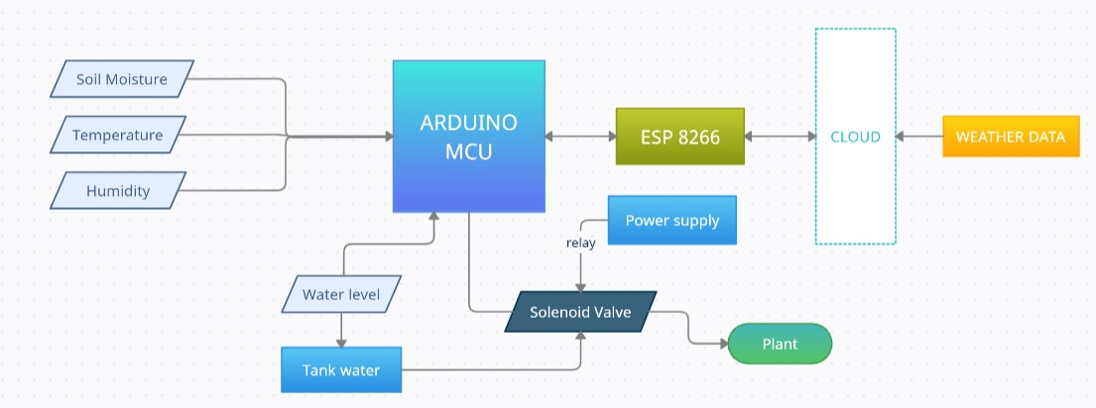
Block Diagram:

Slide 4
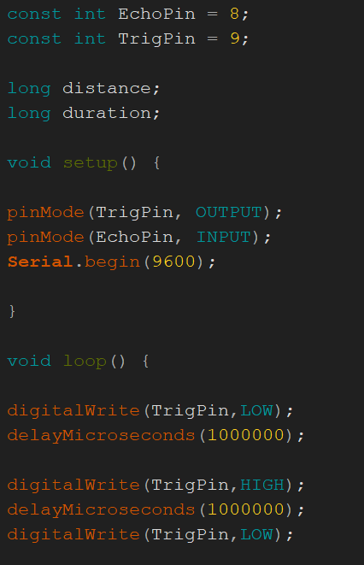
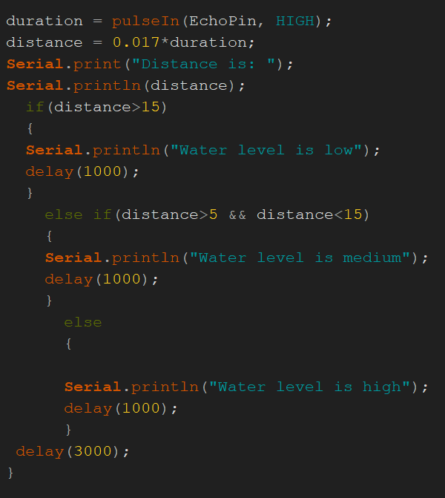
Ultrasonic Sensor - Module Code

Slide 5
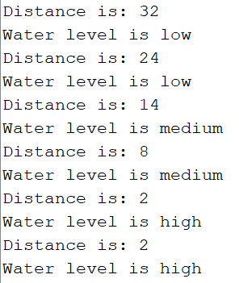
Ultrasonic Sensor - Code Functionality
Function:
Measures the water level in the tank
Gives three water level indications
(i) Low
(ii) Medium
(iii) High

Slide 6
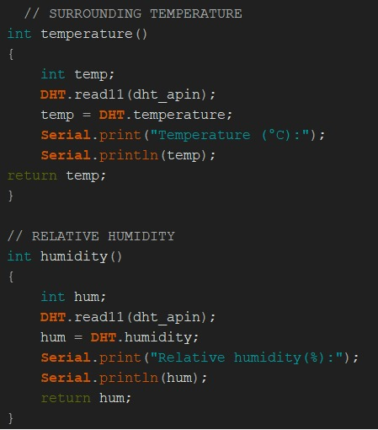
DHT11 Sensor - Module Code

Slide 7
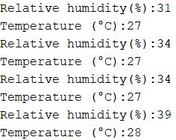
DHT11 Sensor - Code Functionality
Function:
Measures the temperature and relative humidity in the surroundings.
The obtained data can be used to set the threshold values to actuate the solenoid valve.

Slide 8
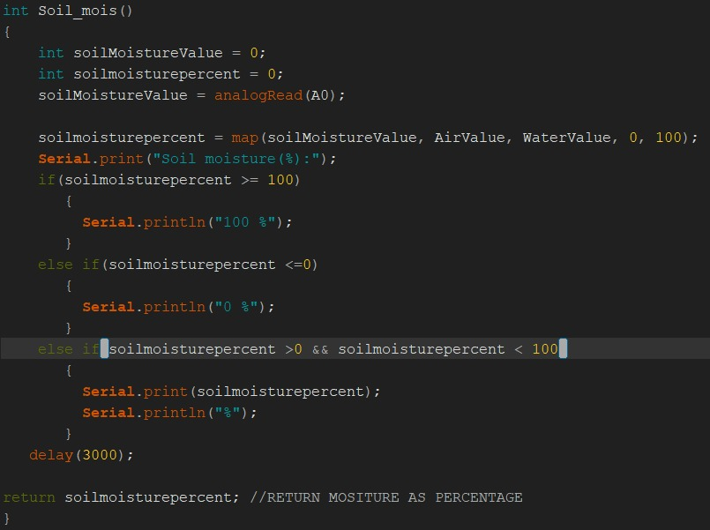
Capacitive Soil Moisture Sensor - Module Code

Slide 9
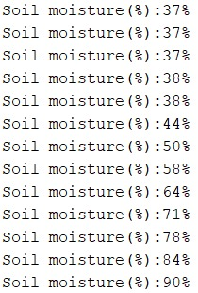
Capacitive Soil Moisture Sensor - Code Functionality
Function:
The sensor collects the soil moisture level.
The example on the right shows the change in the moisture level after the addition of water to the soil.

Slide 10
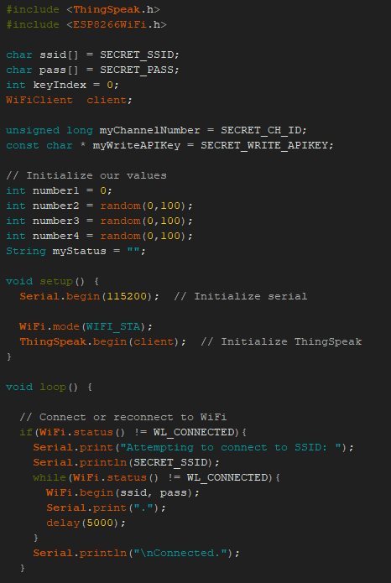
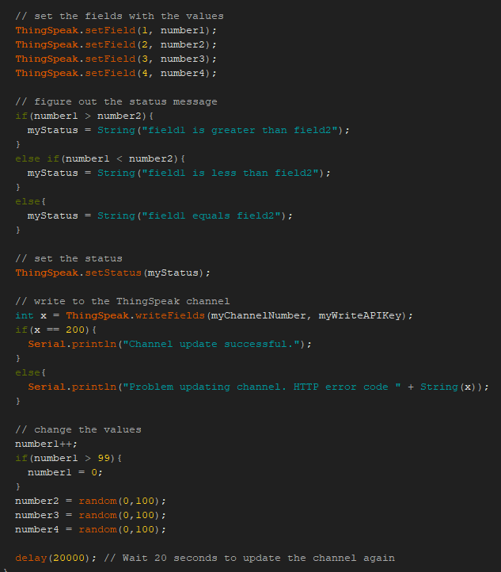
Sending Data to Thingspeak through ESP8266 - Module Code

Slide 11
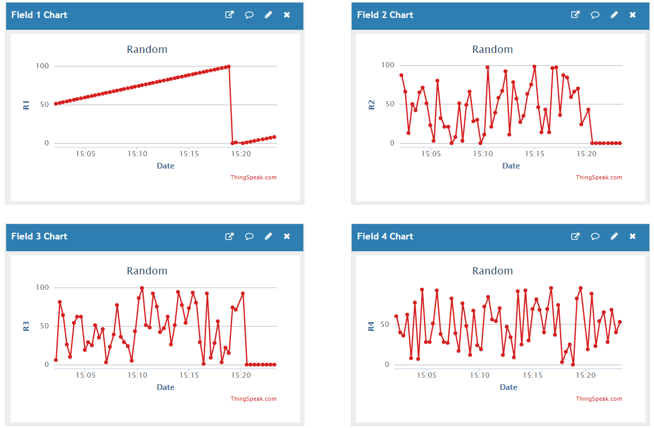
Sending Data to Thingspeak through ESP8266 - Code Functionality
Function:
Data obtained from the sensors is sent to the Thingspeak cloud and can be easily tracked remotely.
The example on the right shows random values being updated to the Thingspeak cloud.

Slide 12
Actuation of Solenoid value using relay
Temperature (Low- up to 30 deg) | Soil Moisture (Dry/Wet) | Water level(in tank) [Low-No water sent] | ON Time (in seconds) [roughly estimated]
LOW | LOW | MEDIUM | 6
LOW | LOW | HIGH | 4
LOW | HIGH | MEDIUM | 0
LOW | HIGH | HIGH | 0
HIGH | LOW | MEDIUM | 5
HIGH | LOW | HIGH | 3
HIGH | HIGH | MEDIUM | 0
HIGH | HIGH | HIGH | 0
The solenoid value will be operational based on the parameters set.
When the threshold values are crossed, the valve will be open for a certain time period depending on the current data values.
The tabular column on the right gives the ON TIME for different cases possible.

Slide 13
Issues faced and solution: Software:
1. Firmware not updated in ESP8266 Wi-Fi module
Sol: Use either Arduino or USB to TTL converter (with ESP8266 in flash mode) and update it.
2. USB drivers for Arduino - not working
Sol: Install CH340 driver (TTL to USB converter)
3. USB COM Port not detected?
Sol: Try changing the COM port or the data cable itself
4. Messy code?
Sol: Use function modules and integrate.

Slide 14
Issues faced and solution: Hardware:
1. Finding a proper coupler to attach the solenoid valve to the water tank(here, drum)
Sol: Using a stainless-steel pipe coupling along with Teflon tape and M-Seal to prevent leaks
2. Not enough power to drive all sensors(consumes in order of mW)
Sol: We generally use 5V from Arduino - better to power externally using Lithium-ion battery with Lipo tester (rechargeable)
3. Constant and stable 3.3V supply to ESP8266
Sol: Using 3.3V from Arduino might damage the module - use a 3.3V regulator and step down.
4. Damage of ESP8266 due to TX of Arduino (5V transmission can fry the ESP8266)
Sol: Use a voltage divider circuit to reduce to 3.3 (2.2kohm and 1k ohm)
5. Loose wire connection in Breadboard
Sol: Always test connections using a multimeter
TIP: Use capacitors in power voltage regulator supply to filter only DC voltage

Slide 15


